Slide 1
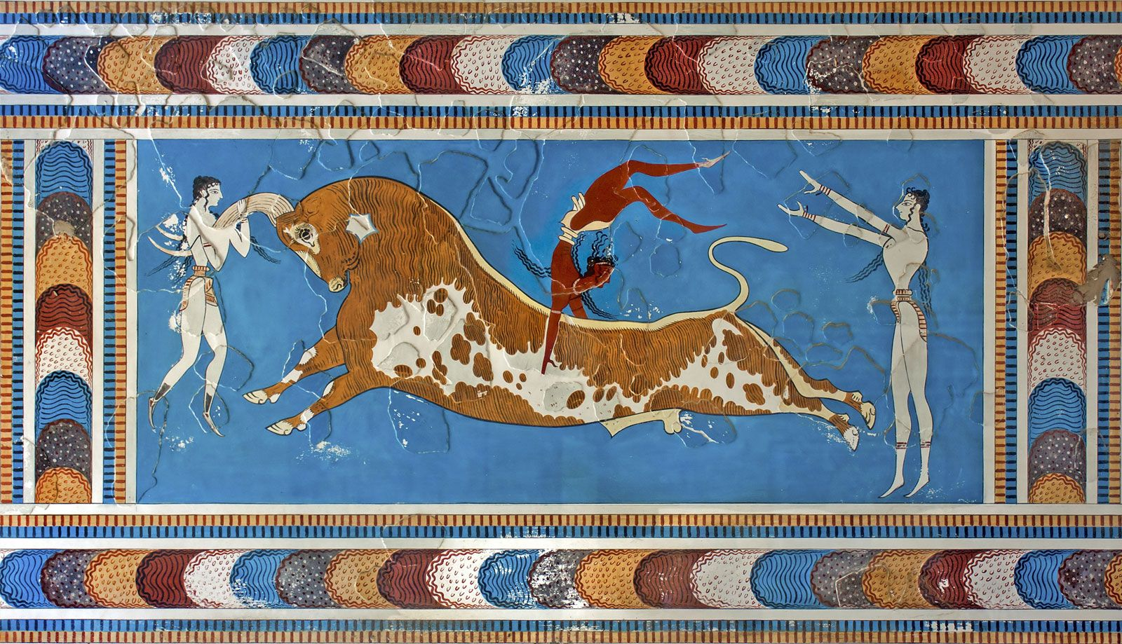
Minoans – Political Structures
Goal/s:
Identify and describe the key features of the Minoan political structures
Week 3 Lesson 2
Ms Barrie

Slide 2
Today’s Lesson
political structure of minoan society

Slide 3
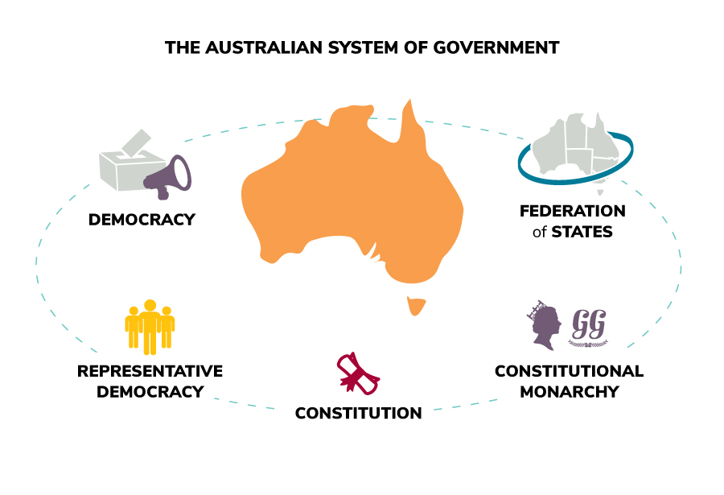
Political Structure
KEY TERM
DEFINITION:
The set of formal legal institutions that constitute a ‘government’ or ‘state’
What political structures do you already know of?

Slide 4
ACTIVITY – Types of Government
Draw the following table in your book (half a page)
Type | Description
Monarchy
Aristocracy
Oligarchy
Tyranny
Democracy

Slide 5
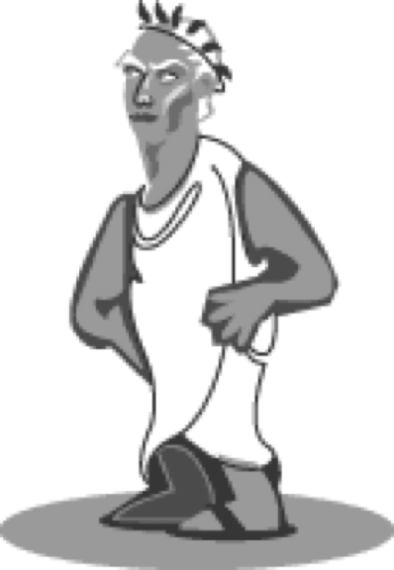
Monarchy
At first, most city-states were ruled by kings.
Greek words mono meaning ‘one’ and arkho meaning ‘rule’.
King rules with the help of a council of nobles or rich landowners called the aristocracy. On the death of a king, his eldest son took his place.
‘Hereditary rule’: power is passed on through the one family.

Slide 6
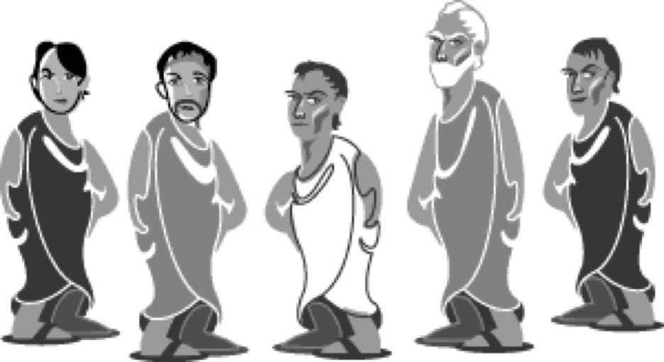
Aristocracy
By 800 BC many city-states were ruled by rich landowners.
From the Greek words aristos, meaning ‘the best people’ and kratos meaning ‘power’.
In an aristocracy, power is inherited or passed down from parents to their children.

Slide 7
Oligarchy
Small group rules
From the word oligos, meaning ‘the few’.
Such a powerful small group might arise from the aristocracy, the wealthy, the military, strong individuals or those experienced in government.

Slide 8
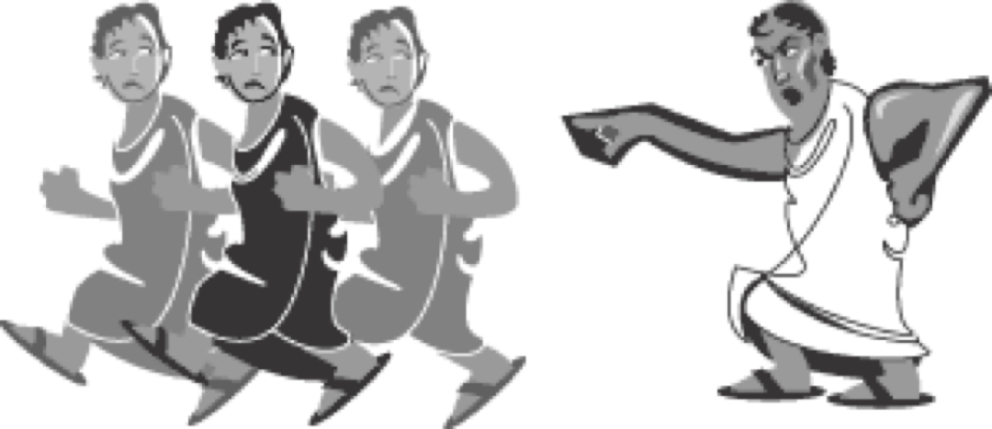
Tyranny
Sometimes a strong individual seized power and ruled alone.
From the Greek word turannos, meaning ‘cruel ruler’.
This is a word still used today, but the more common word now for a ruler who seizes power and rules alone is a dictator, and the form of government is called a dictatorship.

Slide 9
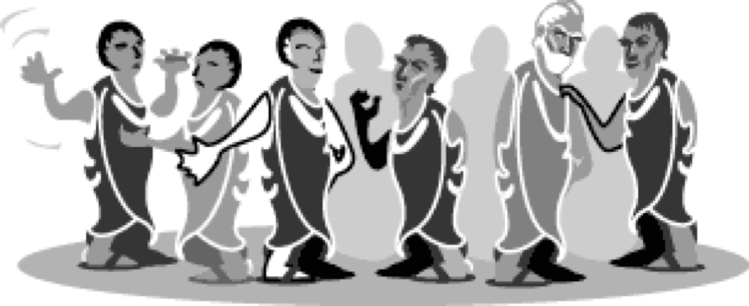
Direct Democracy
The biggest city-state, Athens, experienced all these types of government at different times, but the ordinary citizens of Athens gradually got more and more say in how they were governed until, by around 500 BC, it became a democracy, from the Greek words demos, meaning ‘the people’ and kratos meaning ‘power’.

Slide 10
What type of government did the Minoans have?

Slide 11
The Minoans
The island of Crete was ruled by a monarch, his kingdom being in the central palace of Knossos.
Each palace throughout Crete had its own sum of independence. The only known ruler of the Minoans was King Minos, also being the first ruler.
Minos was claimed to be the son of the ancient god Zeus, who appointed him to be the ruler of Crete. He also was the owner of the legendary Minotaur and the Labyrinth. Minos wasn't much of a dictator though, just like the rest of the monarchs. Yes, they were in charge, but they didn't flaunt around their powers.
Most decisions were made by a 'priesthood', mainly consisting of women. The Minoans were given a large degree of freedom. This caused the lack of gender inequality and poorness.
Notes:
Highlight key words to write down

Slide 12
ACTIVITY AND EXIT TICKET
Complete
Complete the worksheet about Greek City-States and the SUMMARY question.
Bring
When complete, bring to Ms Barrie to be checked.
Pack up
Once checked, pack up. You may complete private study before the bell.

